Slide 1
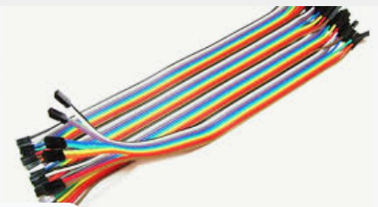
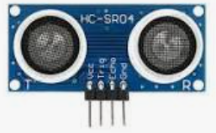
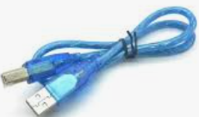
DISTANCE MEASUREMENT WITH ULTRASONIC SENSOR and ARDUINO
Components to be used:
Ultrasonic Sensor
Arduino uno
USB Cable
Breadboard
Connecting wires

Slide 2
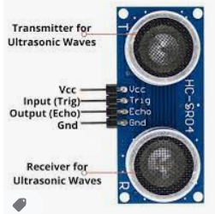

Slide 3
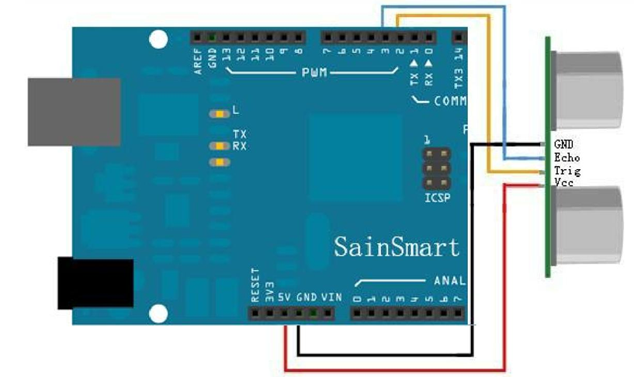
CIRCUIT DIAGRAM

Slide 4
Experiment procedures
1.Connect the circuit as shown by the above circuit diagram
2.Connect microcontroller into your PC
3.Type the Program CODE into computer connected on arduino
4.Compile and download the program into microcontroller
5.place an object at different position relative to the sensor
6. Record the measured distance
7.By using the meter compare the measured values and recorded values

Slide 5
LAB Session
Let connect the circuit diagram.

